Slide 3
KEY TRUTH:
We have been given the authority to bind Satan and evil spirits.
LEARNING OBJECTIVE:
To learn how to bind the powers of darkness and loose ourselves and others from the enemy under the direction of the Holy Spirit.

Slide 4
KEY VERSE:
Matthew 12:29
Or again, how can anyone enter a strong man’s house and carry off his possessions unless he first ties up the strong man? Then he can rob his house.

Slide 5
A. Principles of Combat
1. Act of Obedience
John 15:5
… apart from me you can do …

Slide 6
A. Principles of Combat
1. Act of Obedience
John 15:5
… apart from me you can do nothing.

Slide 7
A. Principles of Combat
1. Act of Obedience
2. Maintain the Warfare Pattern
James 4:7
Submit yourselves, then, to God. Resist the devil, and he will flee from you.

Slide 8
A. Principles of Combat
1. Act of Obedience
2. Maintain the Warfare Pattern
2 Corinthians 10:3-4
For though we live in the world, we do not wage war as the world does. The weapons we fight with are not the weapons of the world. On the contrary, they have divine power to demolish strongholds.

Slide 9
A. Principles of Combat
1. Act of Obedience
2. Maintain the Warfare Pattern
2 Corinthians 10:3-4
For though we live in the world, we do not wage war as the world does. The weapons we fight with are not the weapons of the world. On the contrary, they have divine power to demolish strongholds.

Slide 10
A. Principles of Combat
1. Act of Obedience
2. Maintain the Warfare Pattern
2 Corinthians 10:3-4
For though we live in the world, we do not wage war as the world does. The weapons we fight with are not the weapons of the world. On the contrary, they have divine power to demolish strongholds.

Slide 11
A. Principles of Combat
1. Act of Obedience
2. Maintain the Warfare Pattern
3. Speak Audibly
Luke 4:35
"Be quiet!" Jesus said sternly. "Come out of him!" Then the demon threw the man down before them all and came out without injuring him.

Slide 12
A. Principles of Combat
1. Act of Obedience
2. Maintain the Warfare Pattern
3. Speak Audibly
4. We are Not Praying
Mark 9:25
He said, "I command you, come out of him.”

Slide 13
A. Principles of Combat
B. Patterns from the Life of Jesus

Slide 14
B. Patterns from the Life of Jesus
1. His Example
Luke 8:29
… Jesus had commanded the evil spirit to come out of the man.

Slide 15
B. Patterns from the Life of Jesus
1. His Example
Mark 1:25-26
“Be quiet!” said Jesus sternly. “Come out of him!” The evil spirit shook the man violently and came out of him with a shriek.

Slide 16
B. Patterns from the Life of Jesus
1. His Example
2. His Command
Matthew 28:18-20
“All authority in heaven and on earth has been given to me. Therefore, go and make disciples of all nations, baptizing them in the name of the Father and of the Son and of the Holy Spirit, and teaching them to obey everything I have commanded you.”

Slide 17
B. Patterns from the Life of Jesus
1. His Example
2. His Command
Matthew 28:18-20
“All authority in heaven and on earth has been given to me. Therefore, go and make disciples of all nations, baptizing them in the name of the Father and of the Son and of the Holy Spirit, and teaching them to obey everything I have commanded you.”

Slide 18
B. Patterns from the Life of Jesus
1. His Example
2. His Command
Matthew 10:7-8
As you go, preach this message: ‘The kingdom of heaven is near.’ Heal the sick … drive out demons.

Slide 19
B. Patterns from the Life of Jesus
1. His Example
2. His Command
3. His Disciples
Luke 10:17
The seventy-two returned with joy and said, “Lord, even the demons submit to us in your name.”

Slide 20
Luke 10:18-19
He replied, “I saw Satan fall like lightning from heaven. I have given you authority to trample on snakes and scorpions and to overcome all the power of the enemy; nothing will harm you.”

Slide 21
Luke 10:18-19
He replied, “I saw Satan fall like lightning from heaven. I have given you authority to trample on snakes and scorpions and to overcome all the power of the enemy; nothing will harm you.”

Slide 22
A. Principles of Combat
B. Patterns from the Life of Jesus
C. Definition of Binding and Loosing

Slide 23
C. Definition of Binding and Loosing
“Binding” is the verbal spiritual process by which we prohibit the operation of Satan and his spirits in a given person or situation.
[Greek - deh’ o - to be in bonds]
THIS IS A “RESTRAINING ORDER”

Slide 24
C. Definition of Binding and Loosing
“Loosing” is releasing or freeing the person or situation from the control or interference of Satan and his spirits.
[Greek - lu o - to loose, put off, dissolve, break up]

Slide 25
A. Principles of Combat
B. Patterns from the Life of Jesus
C. Definition of Binding and Loosing
D. Scripture on Binding and Loosing

Slide 26
D. Scripture on Binding and Loosing
Matthew 12:22-23
Then they brought him a demon-possessed man who was blind and mute, and Jesus healed him, so that he could both talk and see. All the people were astonished and said, “Could this be the Son of David?” …

Slide 27
D. Scripture on Binding and Loosing
Matthew 12:29
Or again, how can anyone enter a strong man’s house and carry off his possessions unless he first ties up the strong man? Then he can rob his house.

Slide 28
THIS IS BINDING AND LOOSING FROM DEMONIC PHYSICAL BONDAGE!!

Slide 29
D. Scripture on Binding and Loosing
Matthew 16:13-19
When Jesus came to the region of Caesarea Philippi, he asked his disciples, “Who do people say the Son of Man is?” …

Slide 30
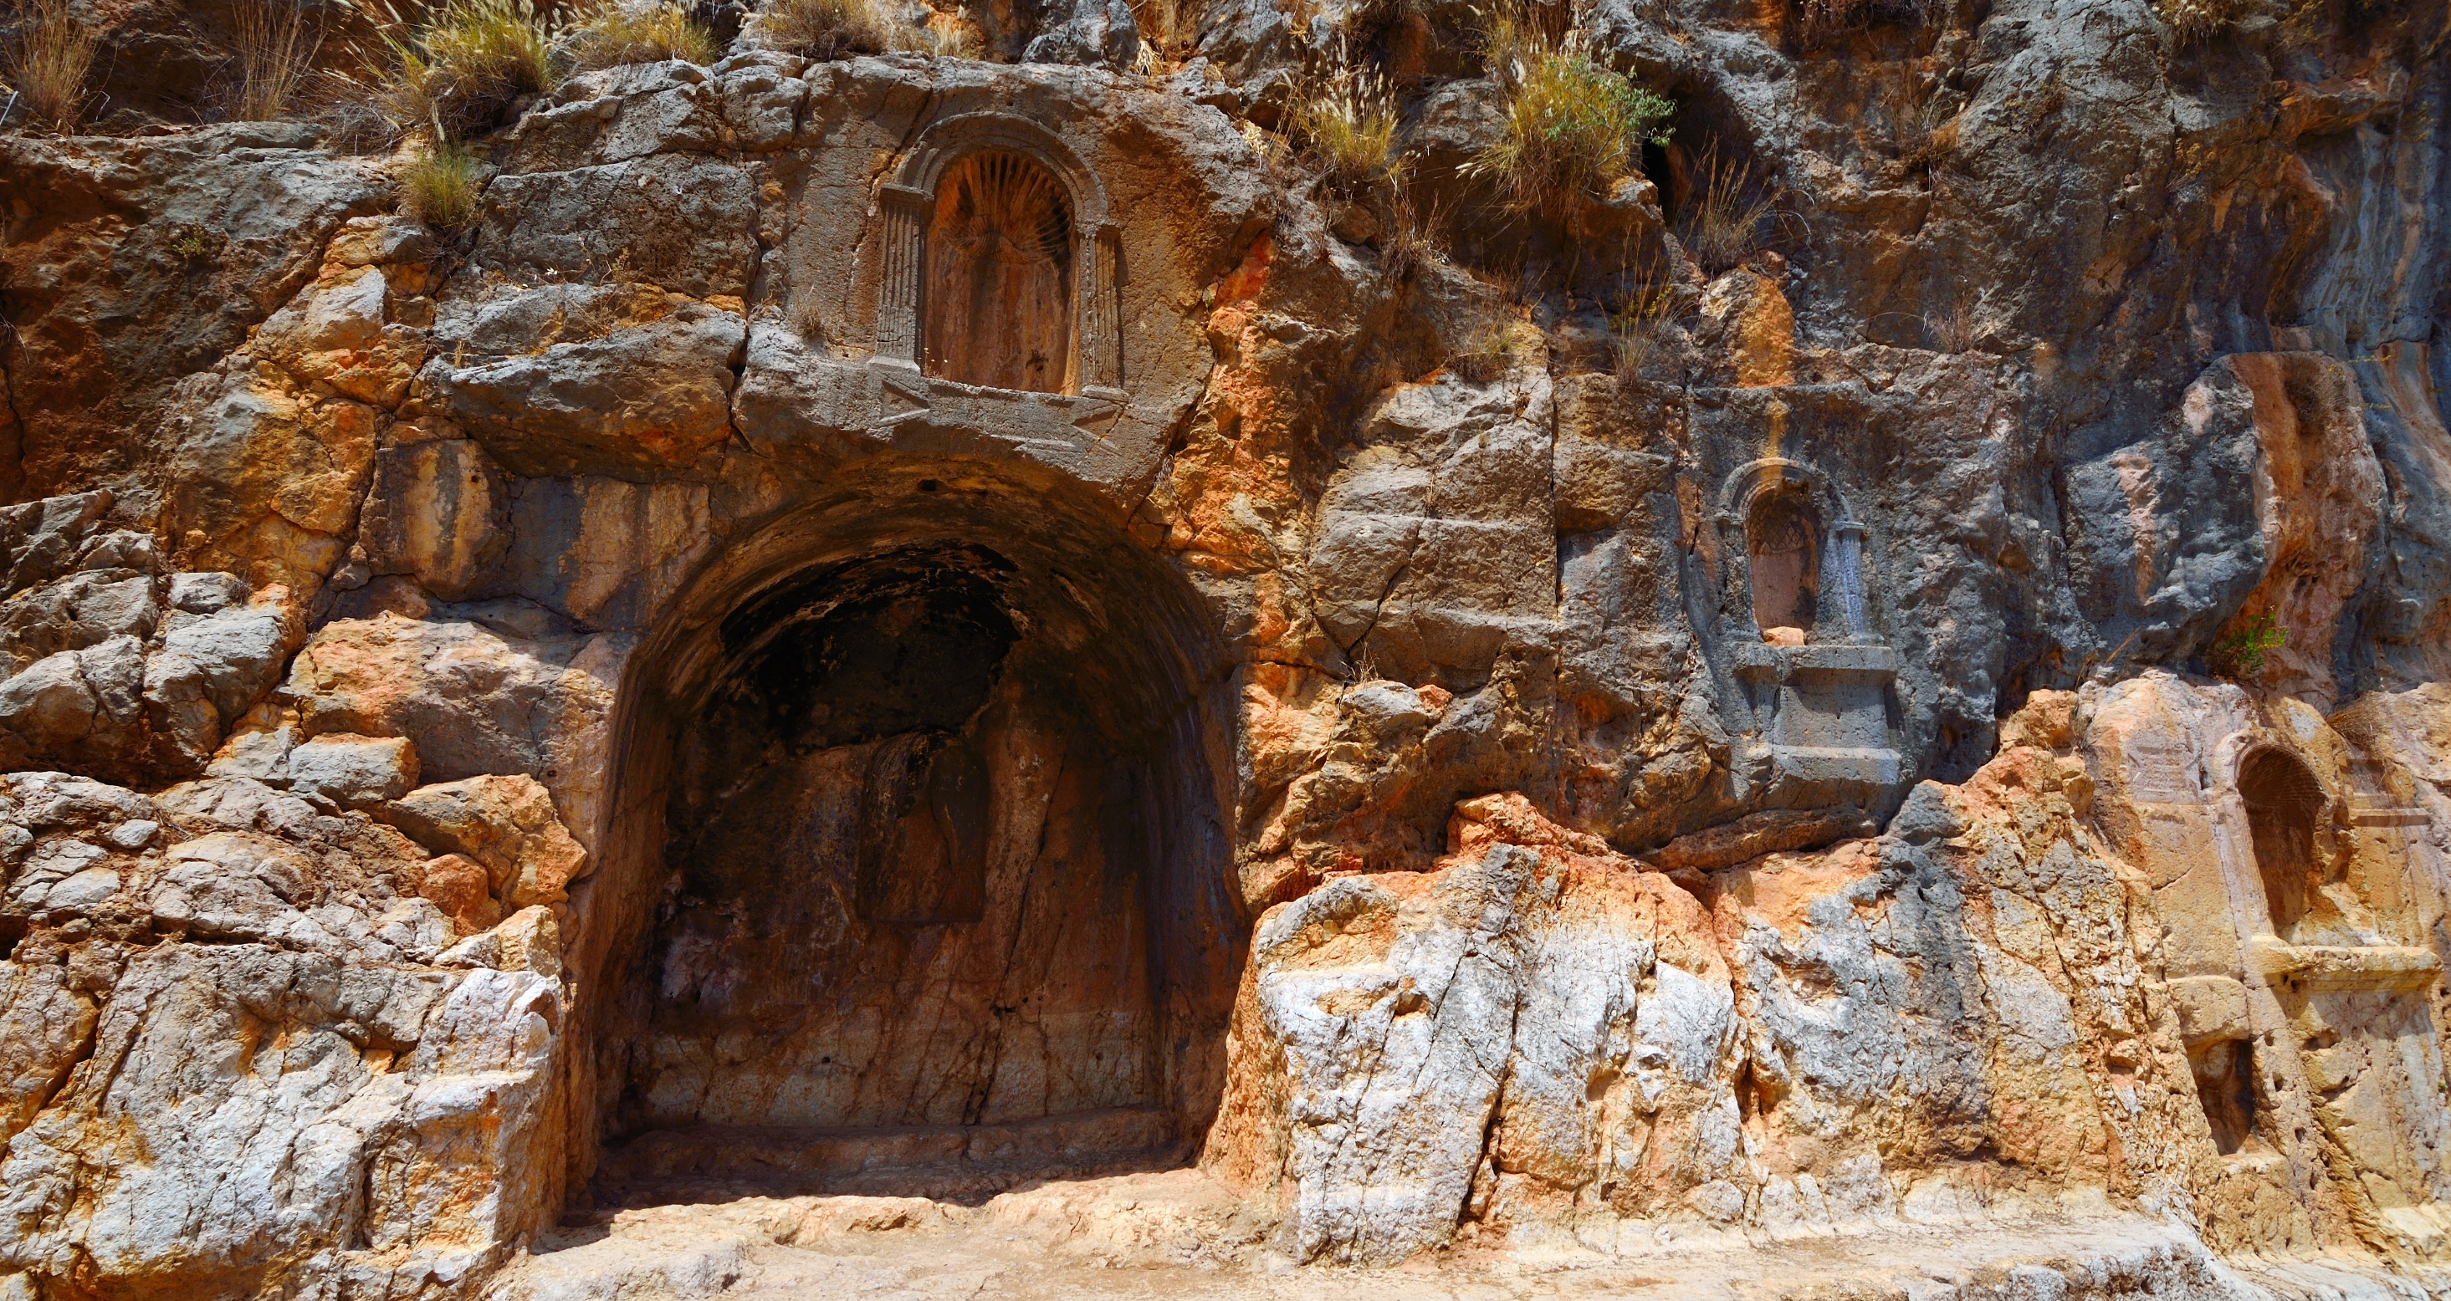
Northern Israel Caesarea Philippi
Temple to Pan

Slide 31
D. Scripture on Binding and Loosing
Matthew 16:13-19
They replied, “Some say John the Baptist; others say Elijah; and still others, Jeremiah or one of the prophets.”

Slide 32
D. Scripture on Binding and Loosing
Matthew 16:13-19
“But what about you?” he asked. “Who do you say I am?”
Simon Peter answered, “You are the Christ, the Son of the living God.”

Slide 33
D. Scripture on Binding and Loosing
Matthew 16:13-19
Jesus replied, “Blessed are you, Simon son of Jonah, for this was not revealed to you by man, but by my Father in heaven. And I tell you that you are Peter, and on this rock I will build my church, and the gates of Hades will not overcome it.

Slide 34
D. Scripture on Binding and Loosing
Matthew 16:13-19
Jesus replied, “Blessed are you, Simon son of Jonah, for this was not revealed to you by man, but by my Father in heaven. And I tell you that you are Peter, and on this rock I will build my church, and the gates of Hades will not overcome it.

Slide 35
D. Scripture on Binding and Loosing
Matthew 16:13-19
Jesus replied, “Blessed are you, Simon son of Jonah, for this was not revealed to you by man, but by my Father in heaven. And I tell you that you are Peter, and on this rock I will build my church, and the gates of Hades will not overcome it.

Slide 36
D. Scripture on Binding and Loosing
Matthew 16:19
I will give you the keys of the kingdom of heaven; whatever you bind on earth will be bound in heaven, and whatever you loose on earth will be loosed in heaven.”

Slide 37
THIS IS BINDING AND LOOSING FOR BUILDING THE CHURCH!

Slide 38
D. Scripture on Binding and Loosing
Matthew 18:12-18
“What do you think? If a man owns a hundred sheep, and one of them wanders away, will he not leave the ninety-nine on the hills and go to look for the one that wandered off?”

Slide 39
D. Scripture on Binding and Loosing
Matthew 18:12-18
“And if he finds it, I tell you the truth, he is happier about that one sheep than about the ninety-nine that did not wander off.”

Slide 40
D. Scripture on Binding and Loosing
Matthew 18:12-18
“If your brother sins against you, go and show him his fault, just between the two of you. If he listens to you, you have won your brother over. But if he will not listen, take one or two others along, so that ‘every matter may be established by the testimony of two or three witnesses.’ ”

Slide 41
D. Scripture on Binding and Loosing
Matthew 18:17
“If he refuses to listen to them, tell it to the church; and if he refuses to listen even to the church, treat him as you would a pagan or a tax collector.”

Slide 42
D. Scripture on Binding and Loosing
Matthew 18:18
“I tell you the truth, whatever you bind on earth will be bound in heaven, and whatever you loose on earth will be loosed in heaven.”

Slide 43
THIS IS BINDING AND LOOSING FOR RESTORATION IN THE CHURCH!

Slide 44
A. Principles of Combat
B. Patterns from the Life of Jesus
C. Definition of Binding and Loosing
D. Scripture on Binding and Loosing
E. Procedure for Binding and Loosing

Slide 45
E. Procedure for Binding and Loosing
1. Prayer of Submission
“Heavenly Father, I give you the control of my mind, emotions, will, and body. I invite you to be Lord of my life, and to reign in me in the name of the Lord Jesus Christ.”

Slide 46
E. Procedure for Binding and Loosing
2. Prayer for Equipping
“Lord, I take for today the provision you have made for me: The belt of truth, the breastplate of righteousness, the readiness that comes from the gospel of peace, the shield of faith, the helmet of salvation, sword of the spirit, and prayer.”

Slide 47
E. Procedure for Binding and Loosing
3. Declaration of binding and loosing
“Satan, I have submitted myself to God and I resist you now in the name of the Lord Jesus Christ. I take authority over you and all your evil spirits and I bind all of you in the name of the Lord Jesus Christ with regard to my life, the life of (my wife, my husband, my son, etc.).”

Slide 48
E. Procedure for Binding and Loosing
3. Declaration of binding and loosing
“You will not have control of our minds, our emotions, our wills, or our bodies. I command that you loose us from every work of yours that is contrary to the will of God, and on the authority of the Word of God, I command you to flee from us now in the name of the Lord Jesus Christ!”

Slide 49
E. Procedure for Binding and Loosing
4. Binding in specific areas of struggle
“I further bind all spirits (of anger, fear, etc., and, all spirits that have caused her/him to [describe the symptoms] ) that have come against (my wife, husband, son, etc.). I command that you loose (her/his) mind, emotions, will, and body. I order you to flee from (her/him) in the name of the Lord Jesus Christ.”

Slide 50
E. Procedure for Binding and Loosing
5. Prayer for protection
“Heavenly Father, I ask you to guard my (wife, son) and to deliver (her, him) from the evil one. I invite your protection in every area of (her/his) life in the name of the Lord Jesus Christ.”

Slide 51
THIS IS BINDING AND LOOSING FOR FREEING MY LIFE & MY FAMILY!

Slide 52
A. Principles of Combat
B. Patterns from the Life of Jesus
C. Definition of Binding and Loosing
D. Scripture on Binding and Loosing
E. Procedure for Binding and Loosing
F. Reason for Binding and Loosing

Slide 53
F. Reason for Binding and Loosing
James 4:7
Submit yourselves, then, to God. Resist the devil, and he will flee from you.

Slide 54
F. Reason for Binding and Loosing
James 4:7-8
Submit yourselves, then, to God. Resist the devil, and he will flee from you. Come near to God and he will come near to you.

Slide 55
Come near to God and he will come near to you.

Slide 56
THIS IS BINDING AND LOOSING FOR THE GLORY OF GOD

Slide 57
Lighthouse Ministry International
Home Office
P.O. Box 120297 | St. Paul, MN 55112
For Ministry Appointments
(651) 483-0888
Email
info@LighthouseMinistryIntl.org
Web
LighthouseMinistryIntl.org

